Slide 1
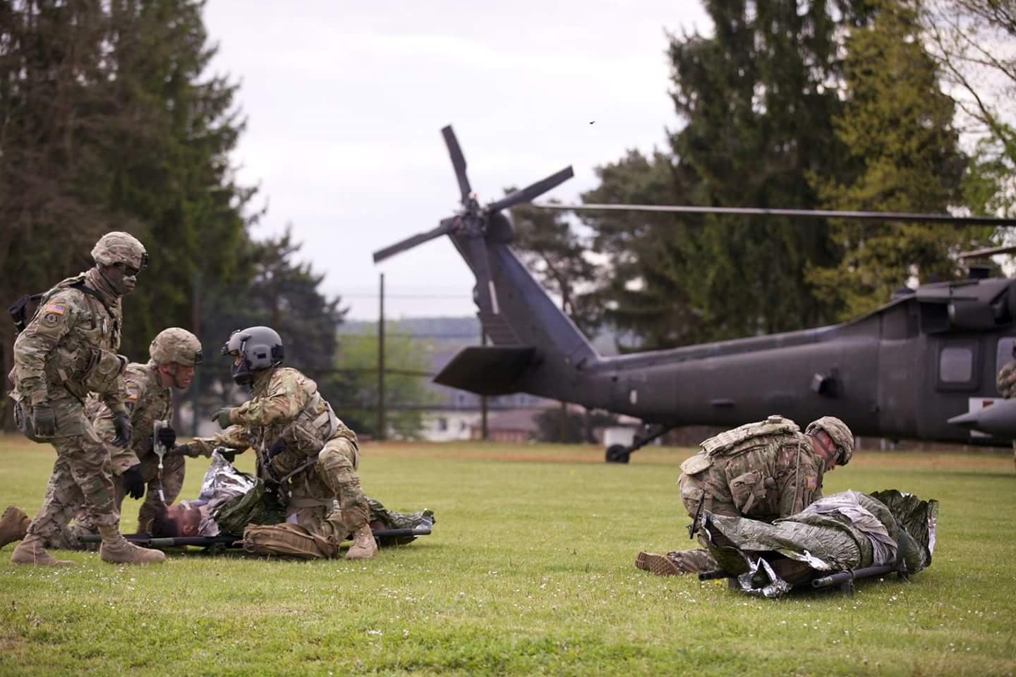
Womack Army Medical Center
Hospital Education and Staff Development (HESD)
FY 25
Delayed Evacuation Casualty Management(DECM)
68W will earn 31 CEUs
2024
07 – 11 Oct 2024
28 Oct – 01 Nov 2024
18 – 22 Nov 2024
02 – 06 Dec 2024
06 – 10 Jan 2025
27 – 31 Jan 2025
10 – 14 Feb 2025
24 –28 Feb 2025
10 – 14 Mar 2025
24 – 28 Mar 2025
14 – 18 Apr 2025
28 Apr – 02 May 2025
12 – 16 May 2025
08 – 13 Jun 2025
23 – 27 Jun 2025
14 – 18 Jul 2025
04 – 08 Aug 2025
18 – 22 Aug 2025
08 – 12 Sep 2025
Training will be conducted at the Taylor Sandri Medical Training Center Training time will be from 0800-UTC
Maximum of 16 students – Students must be current in Skills Validation/TCCC
Request an Enrollment Reservation at least one month prior to the start of the course. Please EMAIL SFC Porterfield: eric.porterfield2.mil@health.mil
or call 910-907-7142

